Slide 1


Offline Consumption
Management Solutions
2021/06/04

Slide 2

Contents
01
02
03
04
Requirement Analysis
Solution Introduction
Product Introduction
Application Scenarios

Slide 3



01
Requirement Analysis

Slide 4


Requirement Analysis
Businesses’
pain points
Employees’
pain points
A lot of cash
Must bring cash
A lot of manual bills
Long queues
Accounting is difficult and troublesome
Lack of ecologically sound records
Notes:
对于企业
工厂的员工人数众多，每天在食堂、商店消费，产生大量现金交易，找零、记账、核账是件头痛的事情。
对于员工
每天都要携带现金、零钱，消费的时候还要等待计费、找零，往往会排起长长的队伍，而且一旦被收错金额，往往很难找回，因为没有个人消费记录。

Slide 5
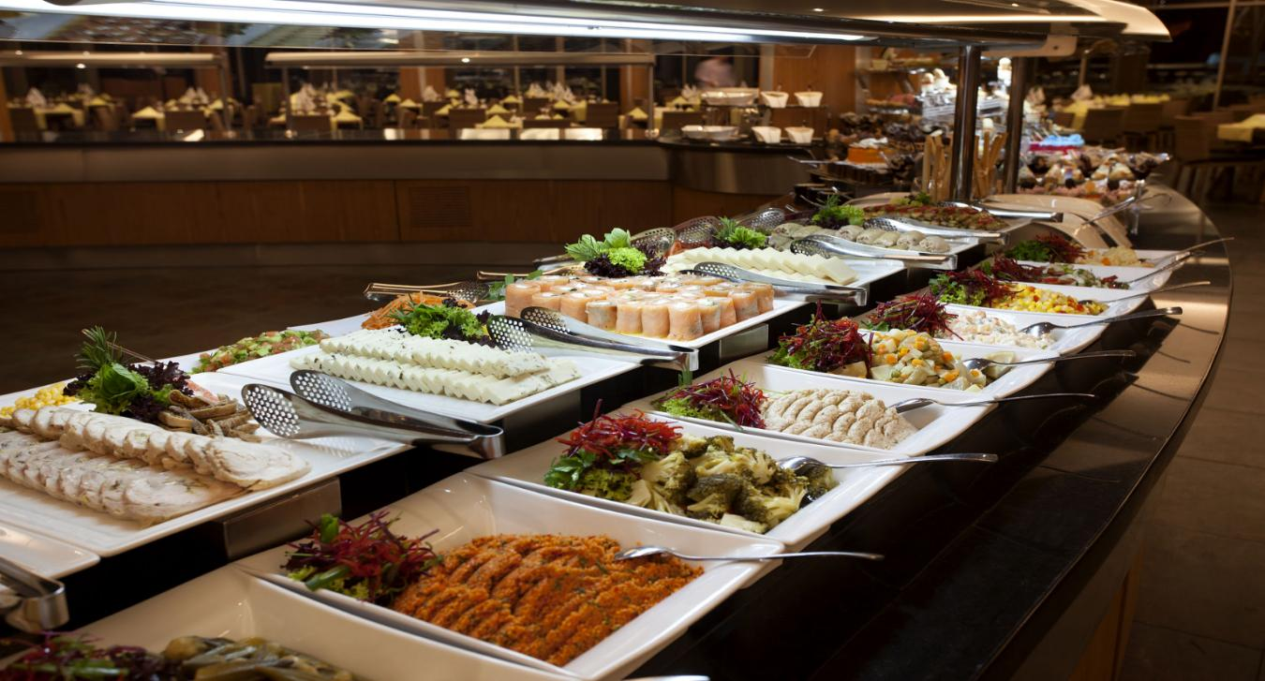







When you use an IC card instead of cash payments, you may save time and avoid long queues.
Smart device accounting avoids human errors, forgery, and tampering.
Consumption Management
Consumption patterns to meet different customer needs: counting, fixed-value, commodities, subsidies, etc.
The system automatically generates statistical reports, easing the pressure on finance employees.
Notes:
百傲瑞达消费管理系统可以解决的问题：
1、IC卡替代现金，提高支付速度，减少排长队现象。
2、电子记账避免人为记错、伪造、篡改问题。
3、多种消费模式满足不同客户的需求：计次、定值、商品、补贴等。
4、自动统计报表，减轻财务压力。

Slide 6

02
Solution Introduction

Slide 7
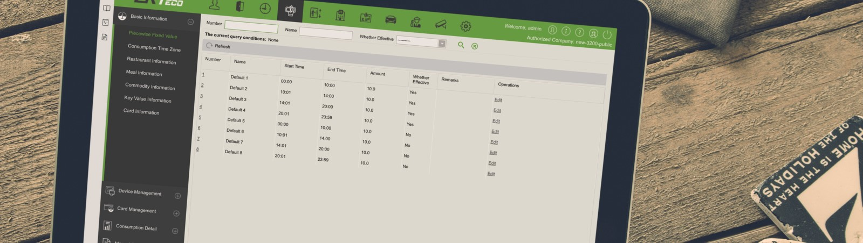

LOGO
Consumption Management
ZKBioSecurity Consumption is a desktop-based restaurant management software module designed to offer restaurants all necessary and useful tools to speed up service and increase efficiency of operation.
The customizable options offered in the system are ideal for any restaurant type including fine dining restaurants, bistros, fast food chains, cafes, etc.
ZKBioSecurity consumption module helps staff members to complete their tasks efficiently in line with their operational style and business.
Notes:
百傲瑞达消费系统是一个桌面式餐厅管理系统，旨在为餐厅提供一切必要和有用的工具，以提升服务质量和提高运营效率。
该系统可以根据客户的设置，适用于任何餐馆类型，包括：高级餐厅、小酒馆、快餐连锁店、咖啡馆等。
百傲瑞达消费模块，帮助员工高效完成任务。

Slide 8




02
Benefits
Supports multiple consumption reports
-Personal Consumption report
-Department Summary report
-Restaurant Summary report
-Device Summary report
-Income And Expenses Report
-Meal Summary report
Supports multiple
model of consumption
-Fixed-value mode
-Amount mode
-Key-value mode
-Counting mode
-Timing mode
-Commodity mode
Supports multiple roles of consumption machine
-Consumption machine
-Cashier machine
-Subsidy machine
Supports multiple fault tolerance mechanisms
-Consumption machine can still be used normally when it is offline
--Manual supplementary consumption records
--Manually correct incorrect consumption records
Notes:
支持多个消费报表
个人消费统计报告
部门统计报告
餐厅统计报告
设备统计报告
收入和支出统计报告
餐次统计报告
支持多个消费模式
定值消费模式
金额消费模式
键值消耗模式
计次消费模式
计时消费模式
商品消费模式
设备支持多种角色
消费机
出纳机
补贴机
支持多种容错机制
消费机离线时仍可正常使用
手工补充消费记录
手动纠正不正确的消费记录

Slide 9

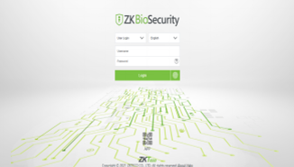
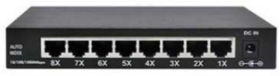
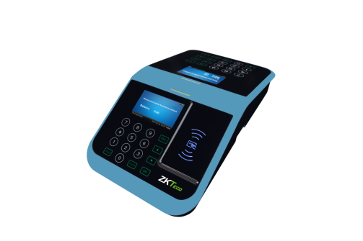
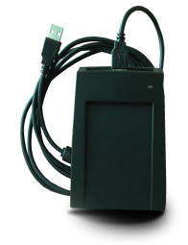
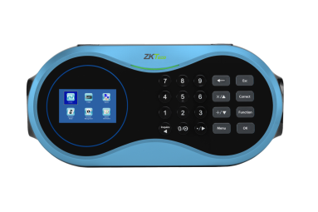
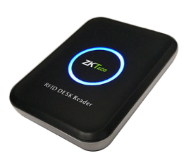
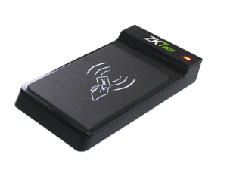
02
System Architecture
ZKBioSecurity V5000
Offline Consumption module
HTTPS
RSA-2048/AES-256
Switch
HTTPS
RSA-2048/AES-256
HTTPS
RSA-2048/AES-256
USB
USB
USB
Promerc-10
Promerc-20
CR30MW
CR20MW
CR10MW

Slide 10

02
Solution Introduction
ZKBioSecurity
Offline Consumption Management System
This system allows the user to set up a consumption system with the device and realize its functions. The device can be set as either a "Consumer Machine", a "Cashier Machine" or a "Subsidy Machine".
The "Consumer Machine" type combines various consumption modes to meet the diversified consumption requirements such as fixed value mode or amount mode.
The "Cashier Machine" type realizes the device recharge and refund function.
The "Subsidy Machine" type is used to receive allowances/subsidies.
This system will collect the data from the device and summarize it on the various consumption reports. It can also perform various operations like Issue Cards, Return Cards, Suspend and Resume Cards, and other operations through the card reader connected to the software.
Notes:
该系统允许用户使用该设备建立一个消费系统，并实现自己的功能。
设备可以设置为“消费机”、“收银机”或“补贴机”。
-“消费机”型结合多种消费模式，满足固定价值模式或金额模式等多样化的消费需求。
-“收银机”式实现设备充值、退款功能。
-“补贴机”类型用于领取补贴/补贴。
该系统将从设备中收集数据并汇总到各种消费报告中。它还可以通过与该软件连接的读卡器执行发卡、退卡、挂卡和恢复等各种操作。

Slide 11
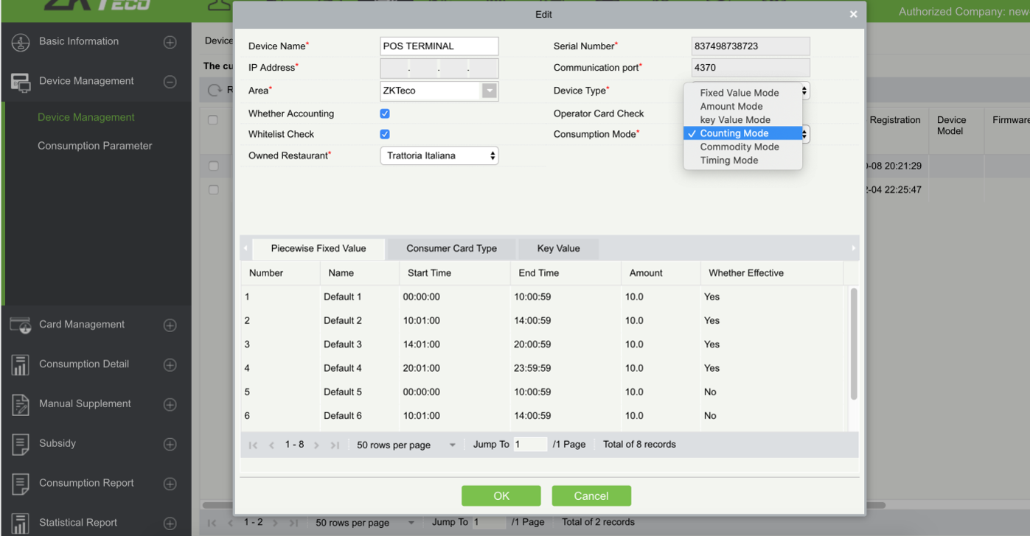
02
Diversification of Equipment Usage and Consumption Mode
Users may switch the device usage to a Consumer Machine, Cash Register, or Subsidy Machine at any time to meet the multi-scenario consumption demand.
Users may also choose to set consumption modes:
Fixed value mode, Amount mode, Key-value mode, Counting mode, Commodity mode, and Timing mode.
Notes:
设备角色和消费模式多样化
用户可随时将设备角色切换到消费机、出纳机或补贴机，满足多场景消费需求。
用户也可以设置设备的消费模式:
定值模式、金额模式、键值模式、计数模式、商品模式、计时模式。

Slide 12
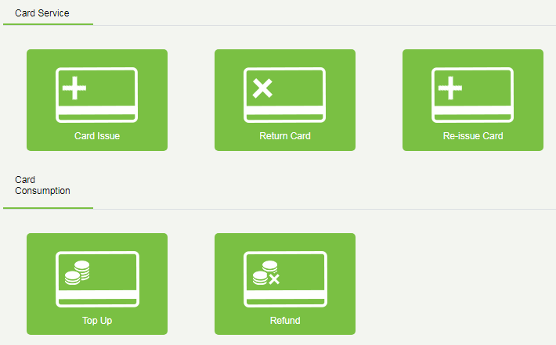
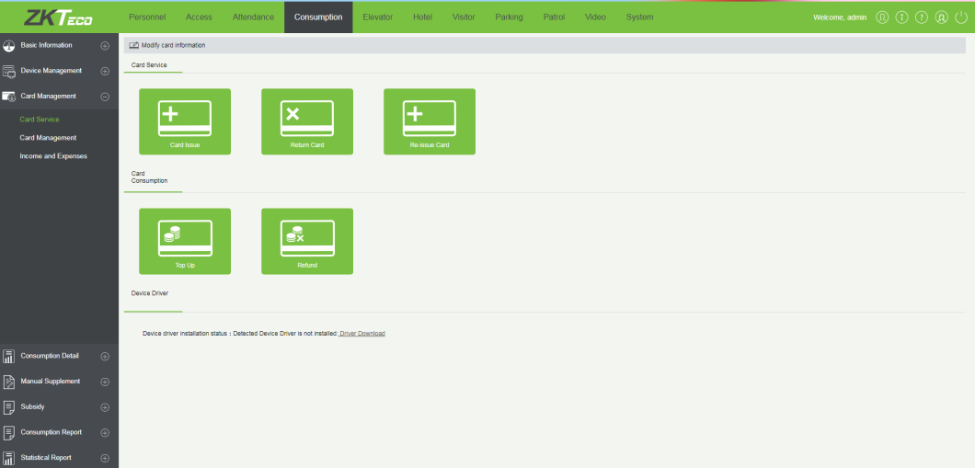
02
Card Management and Multiple-Card Operations
Users may conveniently modify card information, issue card, return card (support non-card return card), replenish card, and other card operations, at the same time to recharge and refund.
All the card information, card, and cash receipts, loss details will be recorded for the convenience of inquiry and system management.
Notes:
支持卡管理和多卡操作
用户可以方便地修改卡信息、发卡、退卡(支持无卡退卡)、补卡等卡操作，同时可以充值、退款。
为方便后续查询和管理，所有的发卡信息、充值卡及现金的收支明细、挂失卡的明细等信息都有记录表。

Slide 13
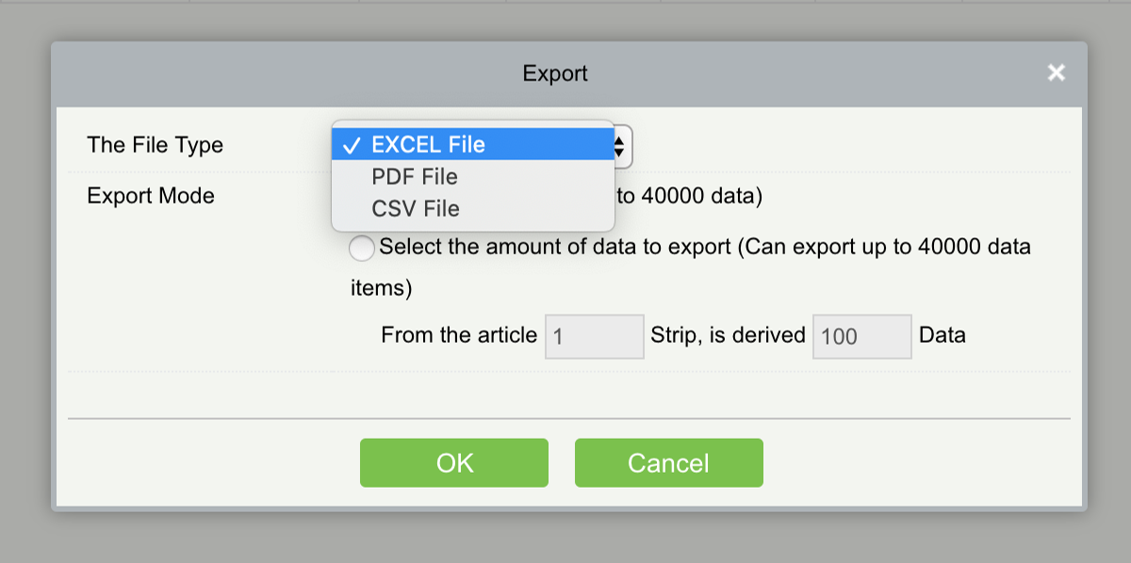
02
Export Consumption Details Report in EXCEL/ PDF/ CSV
Personnel consumption details report supports exporting to EXCEL/PDF/CSV format, and consumption report is screened according to the period required for the query where everyone can have a clear idea about consumption.
Notes:
导出消费明细报表EXCEL/ PDF/ CSV
个人消费明细报表，支持导出为EXCEL/PDF/CSV格式，消费报表可以根据 时间段进行筛选，让每个人都对自己的消费明细了如指掌。

Slide 14
02
Subsidy Management
Attracts an increasingly wide audience by offering benefits to customers who are loyal to your store or regular guests of your restaurant.
Subsidy collection process:
1. Software registration of subsidy is required.
2. After subsidy registration approval is issued to ZKBioSecurity, personnel can use the subsidy machine.
3. Personnel uses a subsidy machine to receive subsidies by swiping cards.
Notes:
补贴管理
为了鼓励回头客，可以通过补贴的形式向餐厅的常客提供福利，吸引更多的客户成为回头客。
补贴操作过程:
1. 软件登记补贴。
2. 审批通过后发给在线补贴机。
3.人员在补贴机上刷卡领取补贴。

Slide 15
02
Consumption Hardware Display
ZKBioSecurity currently supports Promerc-10, Promerc-20 consumer terminals, connected via TCP/IP, which makes it easy for administrators to set up device usage, consumption mode and operate card issuance in the background to link hardware to manage consumption systems.
Reports
The Consumption report includes 9 kinds of statements such as Issue Card table, Top-Up table, Refund table, Subsidy table, Card Suspend and Resume table.
The Statistical report includes Personal Consumption Statistics table, Department Summary table, Restaurant Summary table, Equipment Summary table, Receipt Summary table, and Meal summary table.
Notes:
消费机硬件设备展示
ZKBioSecurity目前支持Promerc-10、promerc-20脱机消费机，通过TCP/IP连接，方便管理员在后台设置设备角色、消费模式、发卡操作，链接硬件管理消费系统。
报表
消费报表包括发卡表、充值表、退款表、补贴表、卡成本表、卡余额表、无卡退卡表、挂失卡恢复表等9种报表。
统计报表包括个人消费统计表、部门汇总表、餐厅汇总表、设备汇总表、收支汇总表、餐次汇总表

Slide 16
03
Product Introduction

Slide 17
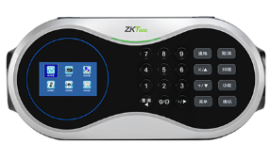
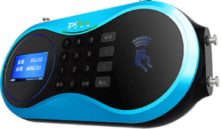
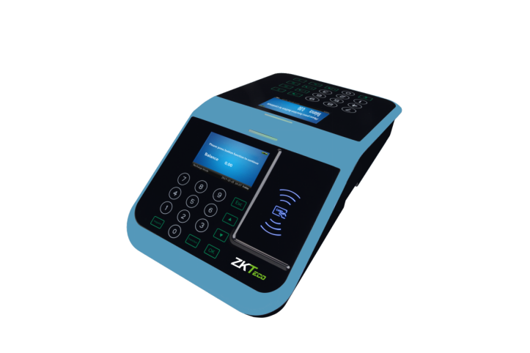
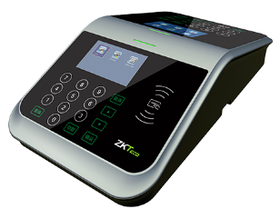
03
Offline Devices
Suspended Type
Promerc-10
Platform Type
Promerc-20
Promerc-10/20 are dual-color screen offline devices(IC type), can be used offline. The details of balance and time/amount limit are kept in cards, result will be written into cards after every consumption.
Software support: ZKBioSecurity, adopts PUSH SDK communication protocol, which only supports network communication rather than 485/232 communication.
Only single wallet firmware available now, version: 6.1.6-20200410.
Notes:
离线设备
挂壁式 Promerc-10
桌面式 Promerc-20
Promerc-10/20为双彩色屏幕脱机设备(IC型)，可脱机使用。余额明细及时间/金额限额均保存于卡内，每次消费后将结果写入卡内。
软件支持:ZKBioSecurity。采用PUSH SDK通信协议，仅支持网络通信，不支持485/232通信。
现在只有一个钱包的固件可用，版本:6.1.6-20200410

Slide 18
03
Single or Dual Wallet
Single Wallet: When consuming, the recharge amount and subsidy amount are mixed as a total value to deduct.
When the device is with single wallet firmware, setting it as a consumer machine or a subsidy machine is an alternative, but a separate subsidy machine is necessary.
Subsidy
Dual Wallet: When consuming, we can set an order that deducts the recharge amount first or subsidy amount first.
Also, a device can be used as a consumer machine or a subsidy machine at the same time rather than using a separate subsidy machine.
We can upgrade the single wallet firmware to dual wallet firmware by a USB later, and there is no need to replace the device, but the issued cards must be returned and issued again.
Notes:
单钱包或双钱包
对于补贴
单钱包:消费时充值金额和补贴金额混合作为总价抵扣。
双钱包:消费时可设置先扣充值金额或先扣补贴金额的订单。
当设备带有单一钱包固件时，可将其设置为消费机或补贴机，因此需要一个单独的补贴机
另外，一种设备可以同时作为消费机或补贴机使用，不需要单独的补贴机。
我们以后可以通过u盘将单钱包固件升级为双钱包固件，不需要更换设备，但是发卡必须退回并重新发卡。

Slide 19
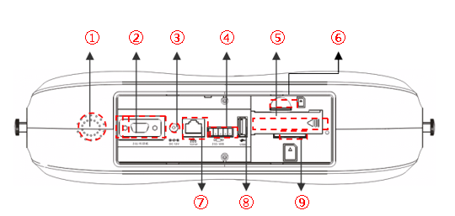
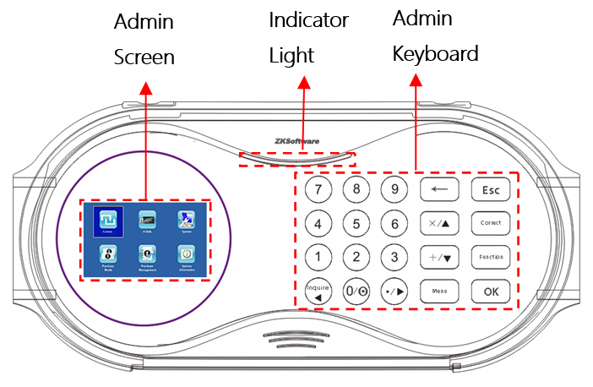
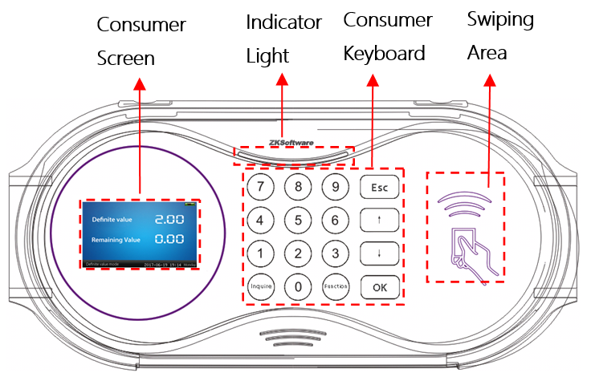
03
Product Introduction - Promerc-10
1.Loudspeaker Port | 5.Backup Battery
2.RS232 | 6.SIM Card Jack
3.Power Input | 7.TCP/IP Port
4.RS232/485 Port | 8.USB Port
9.SD Card Jack
Notes:
产品介绍- Promerc-10

Slide 20
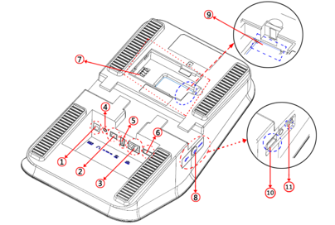
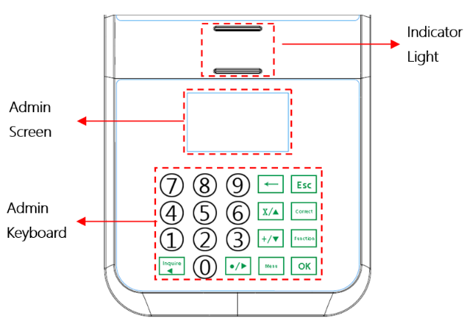
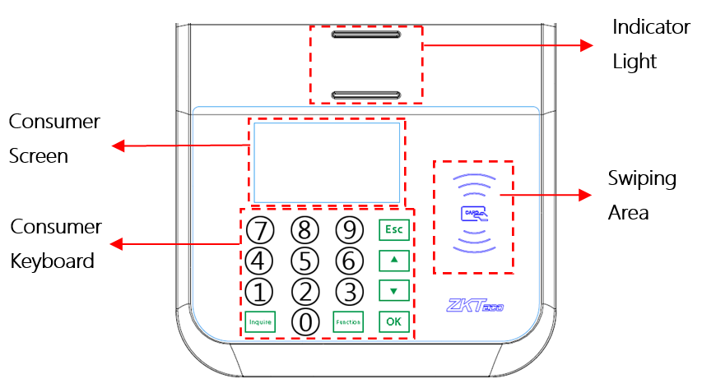
03
Product Introduction - Promerc-20
1.Power input | 6.RS232/485 Port
2.Relay Port | 7.Backup Battery
3.TCP/IP Port | 8.On/Off Button
4.Loudspeaker Port | 9.SD Card Jack
5.USB Port | 10.USB Port
11.Reset Button
Notes:
产品介绍- Promerc-20

Slide 21
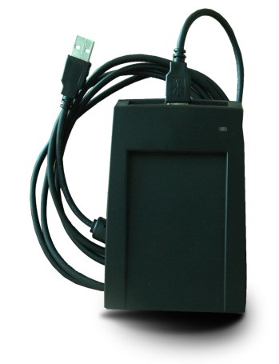


03
Product Introduction - Card Reader
CR10MW
CR20MW
CR30MW
-M means it supports reading Mifare IC cards.
-W means it supports writing as well.
-Supports USB and it is driver-free.
-CR10MW is an old model and its reading and writing speed are slow, so, CR20/30MW is recommended.
-You can also use other card readers which support Mifare IC card.
Notes:
产品介绍-读卡器
-M表示支持读取Mifare IC卡，
-W表示支持写卡。
-usb通讯,免费安装驱动，插上即用
-CR10MW是一个非常老的型号，读写速度很慢，推荐CR20MW/30MW。
-或者你也可以使用其他的支持读写Mifare IC卡的 读卡器设备

Slide 22
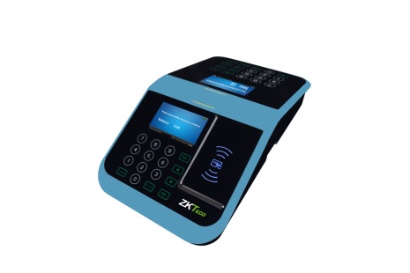

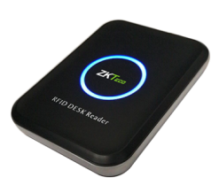
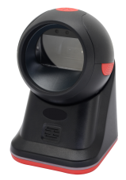

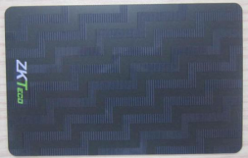
[图片]
03
Product List
Photo
Product Model | Promerc-10 | Promerc-20 | IC card | CR20MW | CR30MW | ZKB209
ERP Code | F01120049 | F01120051 | X00102048 | X00603065 | X02103003 | X00208056
Product Type | Offline Consumption | Offline Consumption | IC Card | IC Card Reader | IC Card Reader | Barcode Scanner

Slide 23
04
Scenarios

Slide 24
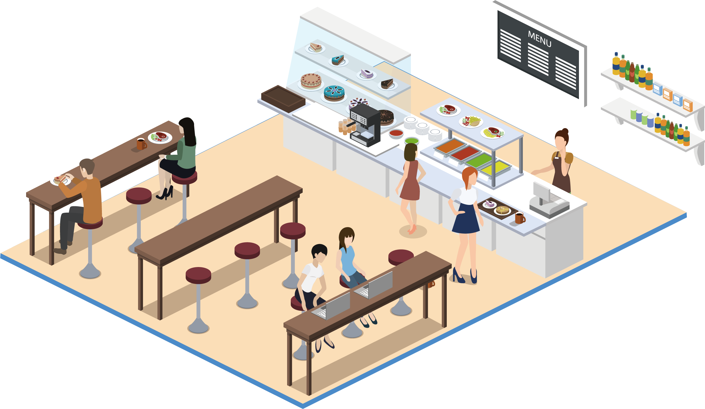
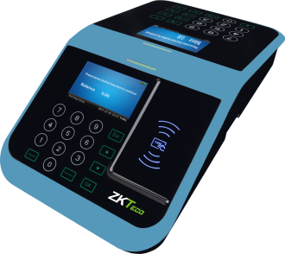
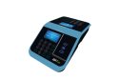
04
Scenario Solution: Dining Hall
Restaurant Name:
Dining Hall
Device Name:
Promerc-10 / Promerc-20
Device Type:
Consumer Machine
Consumption Mode:
Fixed Value Mode
Card Type:
Employee Card
Features:
Because there are many people in the dining hall and the menu is fixed, it is suitable for the mode of fixed value consumption.
The employee card can be set to different consumption time zones to avoid people crowd, which is conducive to the prevention of the COVID-19.
Notes:
因为餐厅人多，菜单是固定的，适合固定价值消费的模式。
员工卡可设置不同消费时区，避开人群，有利于新型冠状病毒感染的预防。

Slide 25
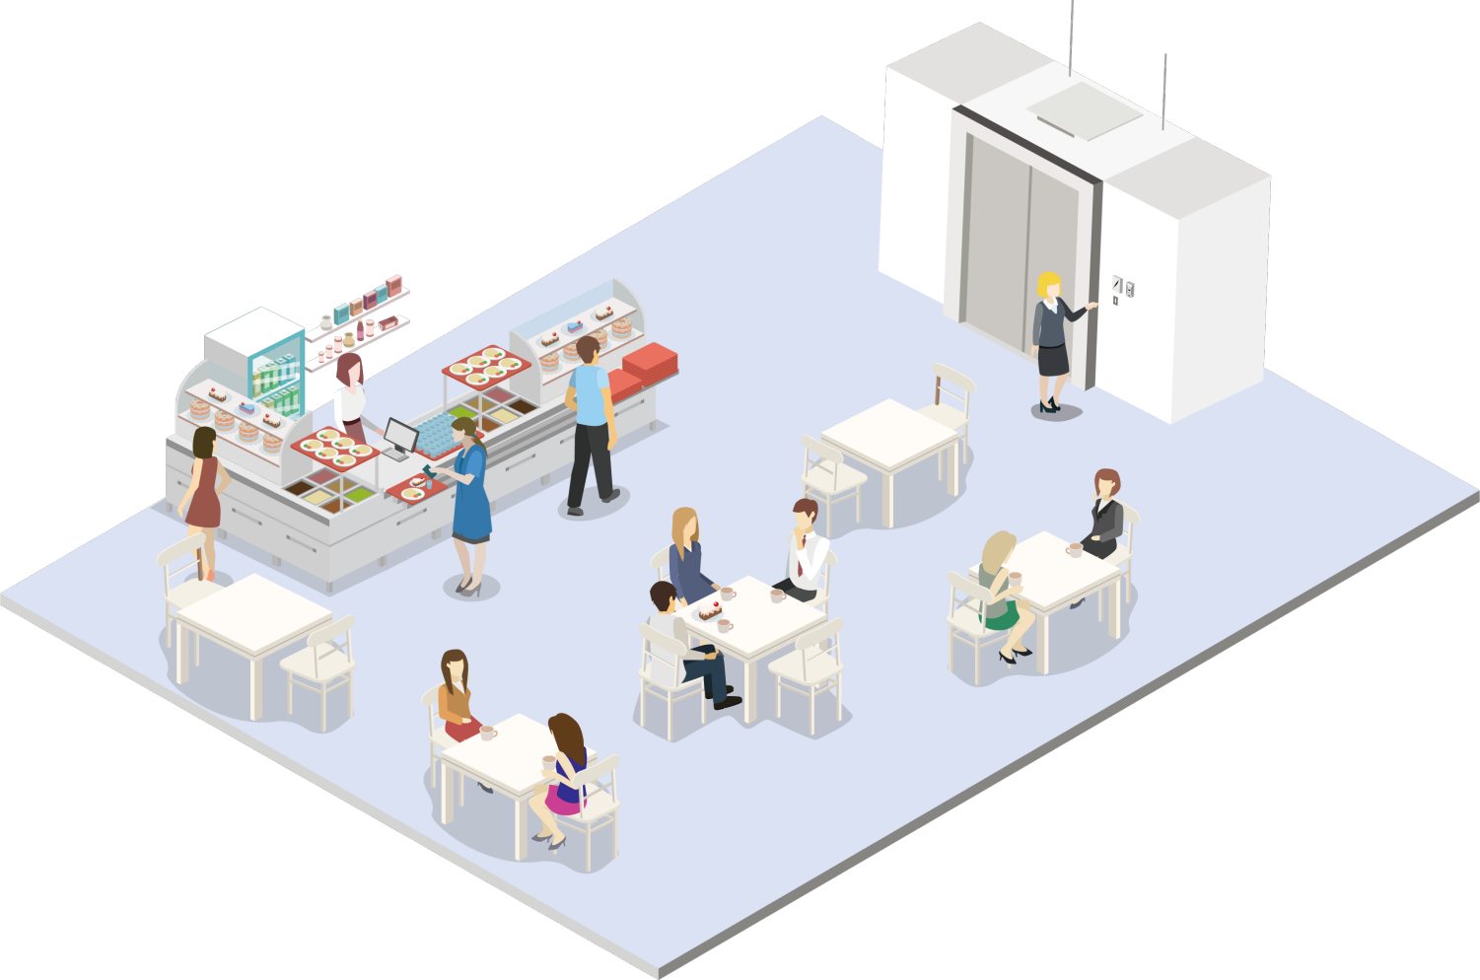
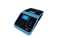
04
Scenario Solution: Tea Cafe
Restaurant Name:
Tea Cafe
Device Name:
Promare-10 / Promare-20
Device Type:
Consumer Machine
Consumption Mode:
Amount mode
Card Type:
Employee Card
Features:
The tea cafe has more dishes and different
amounts, which is suitable for the mode of amount consumption.
Notes:
茶馆菜品较多，量不同，适合量消费模式。

Slide 26

04
Scenario Solution: GYM
Restaurant Name:
GYM
Device Name:
Promerc-10 / Promerc-20
Device Type:
Consumer Machine
Consumption Mode:
Counting Mode
Card Type:
VIP Card
Features:
The gym is suitable for the mode of counting
consumption.The gym can apply for VIP cards for
customers and set the number of times the VIP
card is used.
Notes:
特点:
健身房适合计数消费模式。
健身房可以为客户申请VIP卡，并设置VIP卡的使用次数。

Slide 27

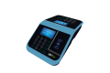
04
Scenario Solution: Beauty Salon
Restaurant Name:
Beauty Salon
Device Name:
Promerc-10 / Promerc-20
Device Type:
Consumer Machine
Consumption Mode:
Amount mode
Card Type:
VIP Card
Features:
The beauty salon has a variety of service items, and the cost is different, which is suitable for the mode of amount consumption.
Beauty salons can apply for VIP cards for customers and set up recharge discount packages.
Notes:
特点:
美容院的服务项目多种多样，费用也各不相同，适合量消费的模式。
美容院可以为客户申请VIP卡，并设置充值折扣套餐。

Slide 28
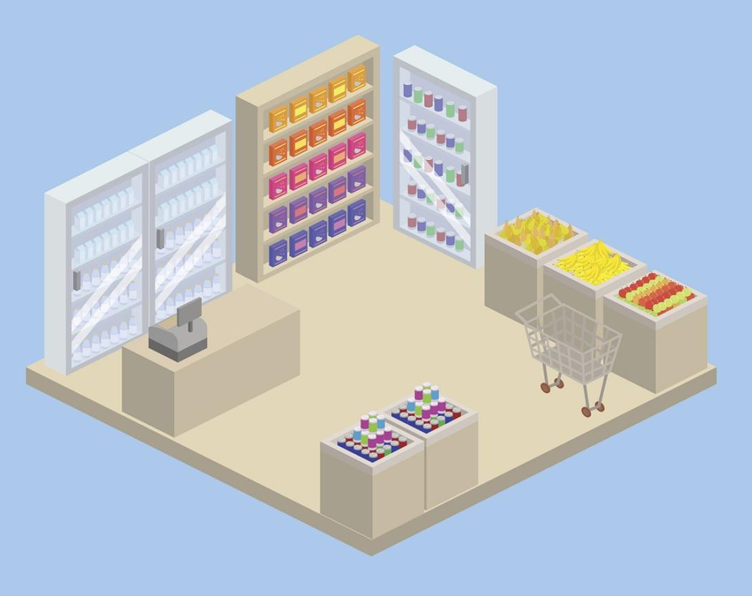

04
Scenario Solution: Hotel store
Restaurant Name:
Hotel Store
Device Name:
Promerc-10 / Promerc-20 + Barcode Scanner
Device Type:
Consumer Machine
Consumption Mode:
Commodity Mode
Card Type:
Hotel Guest Card
Hotel Store
Features:
The hotel can open the consumption authority for the guest's room card. The guest card can open the hotel lock and can also consume in the hotel's store.
The hotel can set the Promerc-20 to credit model. Guests pay for the goods when they check out.
Notes:
特点:
酒店可为客人的房卡开通消费权限。客人卡可以打开酒店锁，也可以在酒店店内消费。
酒店可以将promar -20设置为信用模式。客人在结账时要付货款。

Slide 29





CONTACT US !
lambert.chen@zkteco.com
www.zkteco.com

